Slide 1


WELCOME TO
NBOSECSM EDUCATION FOUNDATION
BECOME A MODEL
India’s Biggest Beauty Pagent
MR, MISS & MRS INDIA 2024

Slide 2


INTERNATIONAL BUSINESS ICON AWARDS 2024
&

Slide 3

GLOBAL
India’s Biggest Beauty Pageant
MR, MISS & MRS INDIA 2024
Welcome to India’s most Dignified Woman Beauty Pageant.Nbosecsm education Foundation is the national Pride and Treasure of India, the pageant is not just conventional beauty pageant; rather, it emphasizes grace, poise, confidence, originality, intelligence, and talent.

Slide 4
About event
Attendees
Chief Guests
Nomination Categories
Award Titles
Beneﬁts & Privileges
Sponsorship Packages
Contact Us
Agenda

Slide 5

About Event

Slide 6


About Event
This is an event for motivating small to big groups of businesses to perform better in their work and achieve new heights of success.
This event aims to reward those who have worked tirelessly to reach where they are today. These awards are designed to identify and honor such respected companies and their key employees.
Business icon awards will be presented to the eminent business personalities across UP state to felicitate them for their exemplary achievements in their respective categories and to motivate them to achieve higher levels of performance.

Slide 7
About Event
The pandemic has left every business in the world with huge losses ﬁnancially and emotionally. This is our small attempt to bring back the lost enthusiasm and energy to the heartbroken business people by recognising their till date achievements with awards and appreciations.

Slide 8
Purpose
Nbosecsm Education Foundation aims to bring together inspiring Entrepreneurs, Business People, Entrepreneur Bosses, People from all walks of life like Vastu Experts & Astrologers, Promising MSMEs , Media Minds & many more to this entertaining and inspirational networking event.
This event will help create new opportunities for the society to build new partnerships and collaboration avenues and highlight social issues so that the much required change starts.
The Event will include keynotes & ignite talks by prestigious names from the business and entertainment ﬁeld which will be
focused on giving opportunities to participants to gain skill &
relationships.

Slide 9
Purpose
The main motive of the event is to give entrepreneurs honour & recognition who have done exemplary work on their own in the pandemic times. The main focus is to create a platform that encourages and empowers more growing organizations and individuals that can help them grow more.

Slide 10
NBOSECSM Education Foundation
Nbosecsm Education Foundation (NEF) is one of India's finest and leading
casting agencies and event management organizations
We are based in Noida and have branches all over India. With more than a decade of experience we have casted several well known faces for Films, TV serials, Advertising Campaigns and other entertainment events.
We excel in bringing together a whole team of Fashion Photographers, Advertising Photographers, studios, make-up artists, Talent Managers, Production House tie-ups under one roof.
One of India's leading, largest, oldest established & the most awarded modelling & casting agency.
One of the most successful, most awarded & most reputed event management company.
●

Slide 11
NBOSECSM Education Foundation
NEF has vast experience of working with industries top & highprofile directors, production houses, national & international brands, advertising agencies, ﬁlm makers, casting directors, music companies, TV channels, choreographers, designers, photographers, celebrities, actors & models from the last 2 years.
We offer excellent opportunities for the people who are motivated and are looking for a challenging future in the entertainment
industry in the ﬁeld of Indian cinema, fashion, media &
advertisement.

Slide 12
NBOSECSM Education Foundation Recent Event
We had recently organised and managed a corporate event in agra (u.p) which was a gathering of 200 to 300 business people from the Healthcare domain. The event was about the anniversary celebration of a renowned medical company. Our team of experts left no stone unturned to make this event memorable.
Pictures of the event are added in the nextslides.

Slide 13

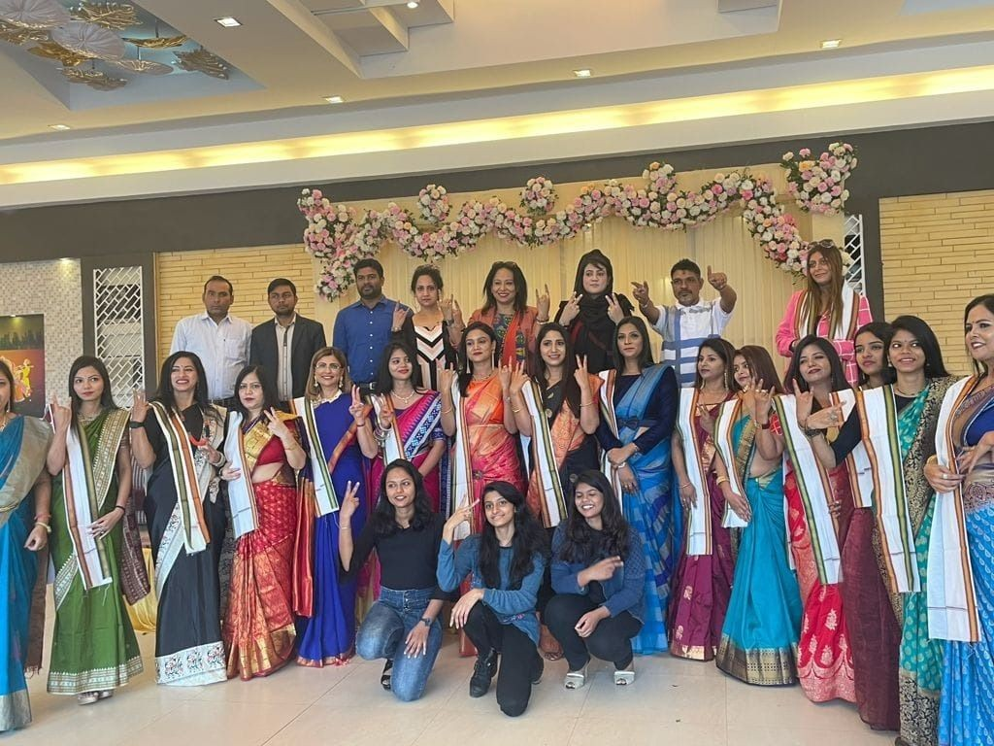

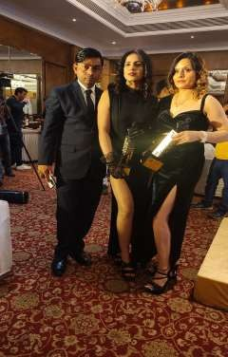

Slide 14
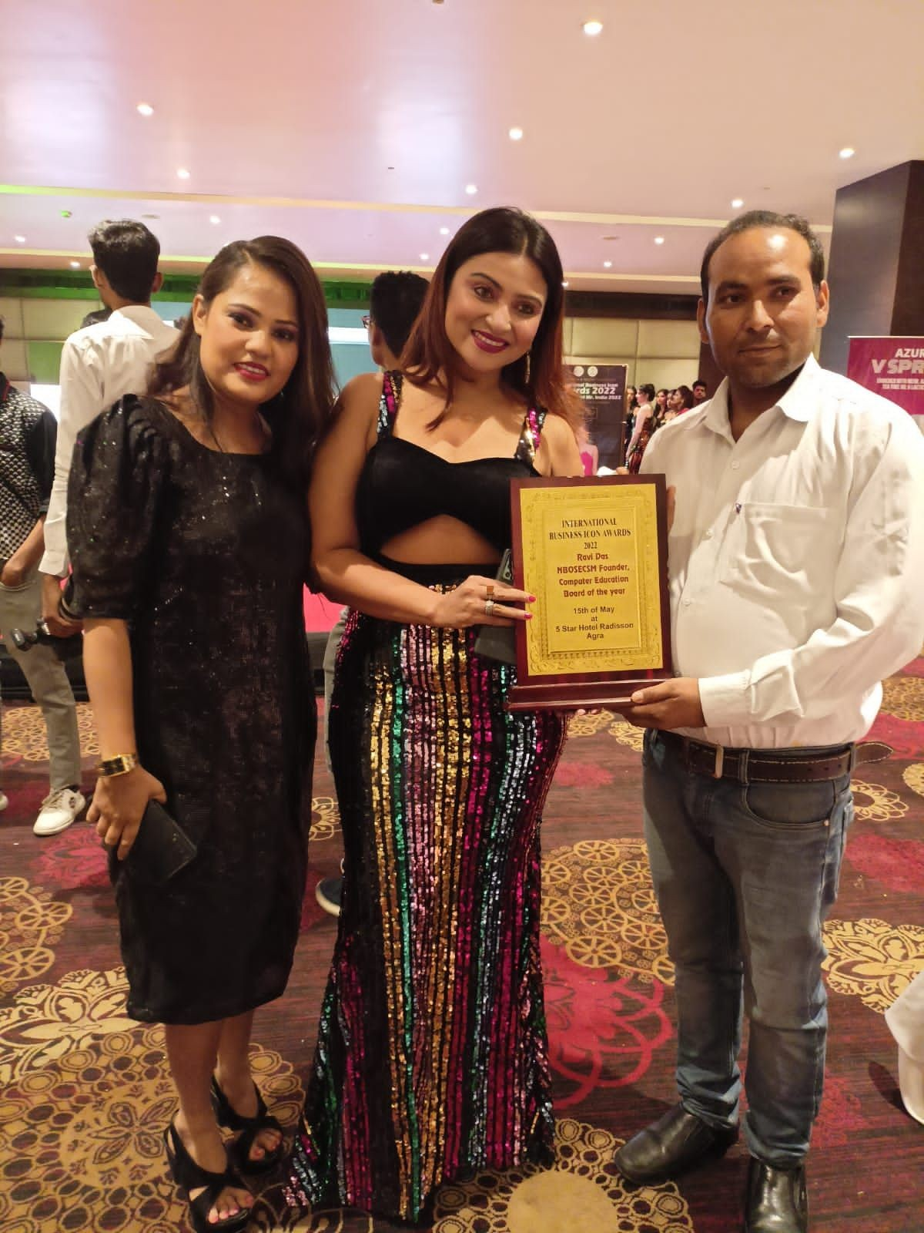
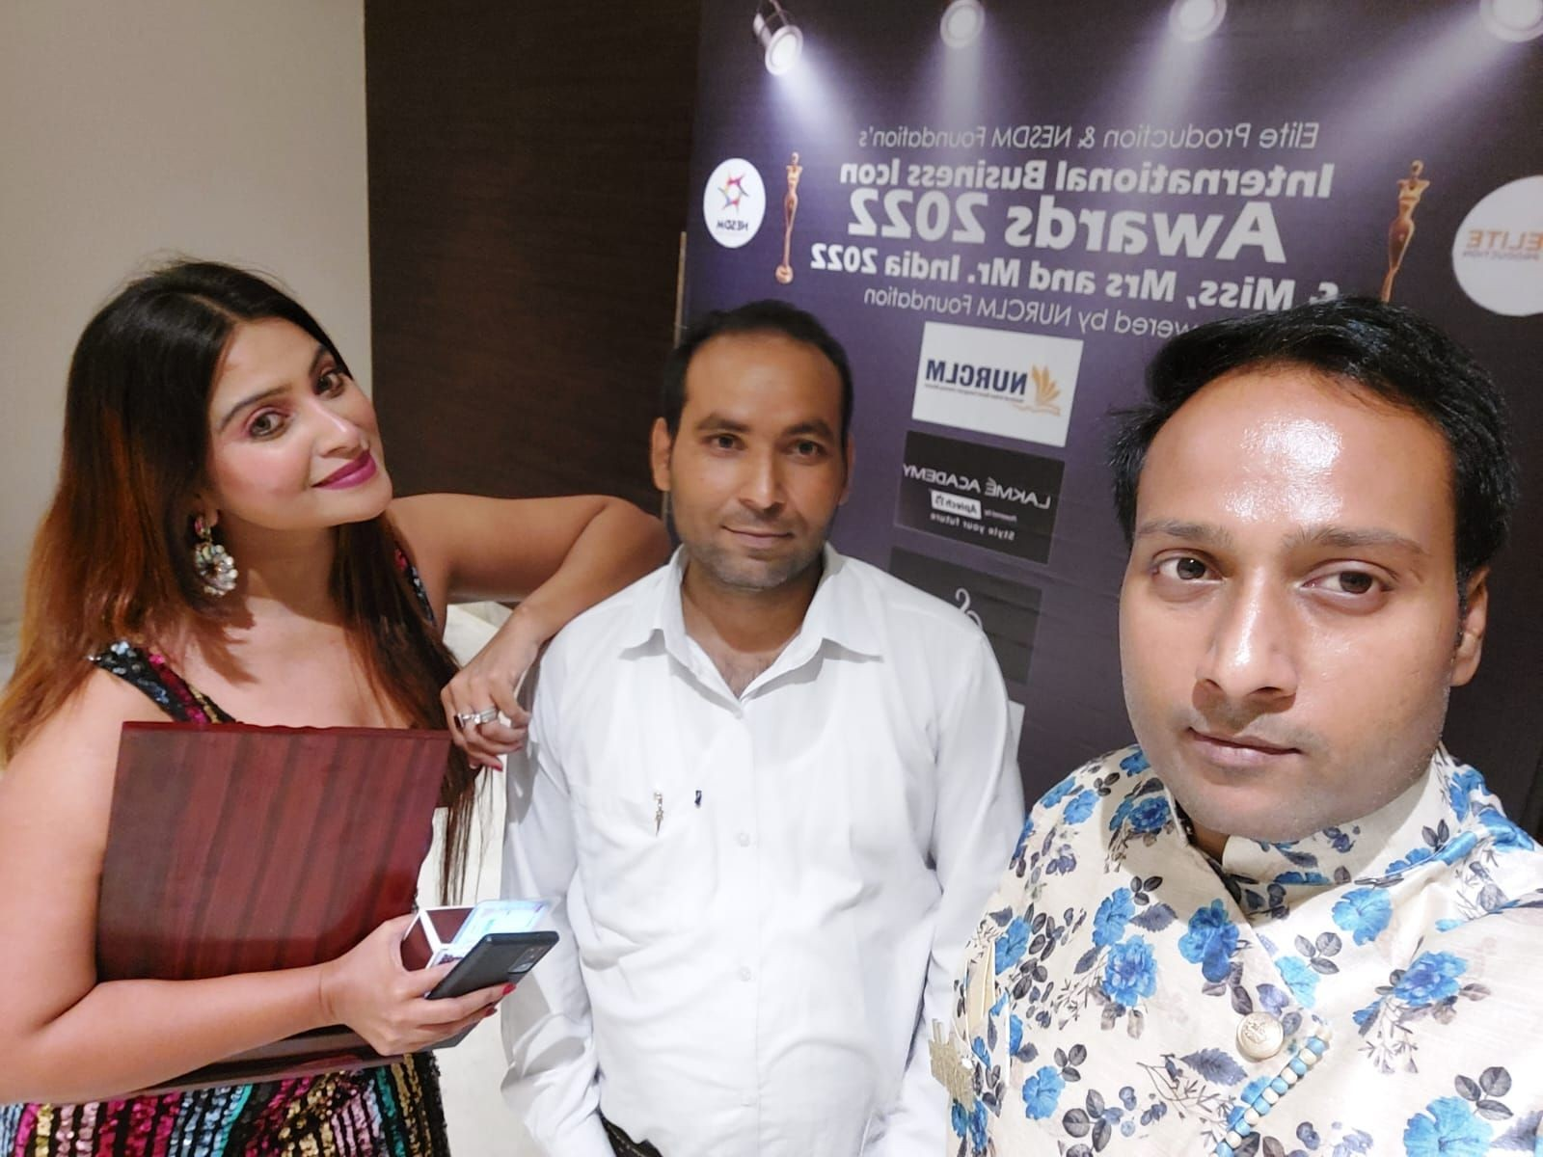
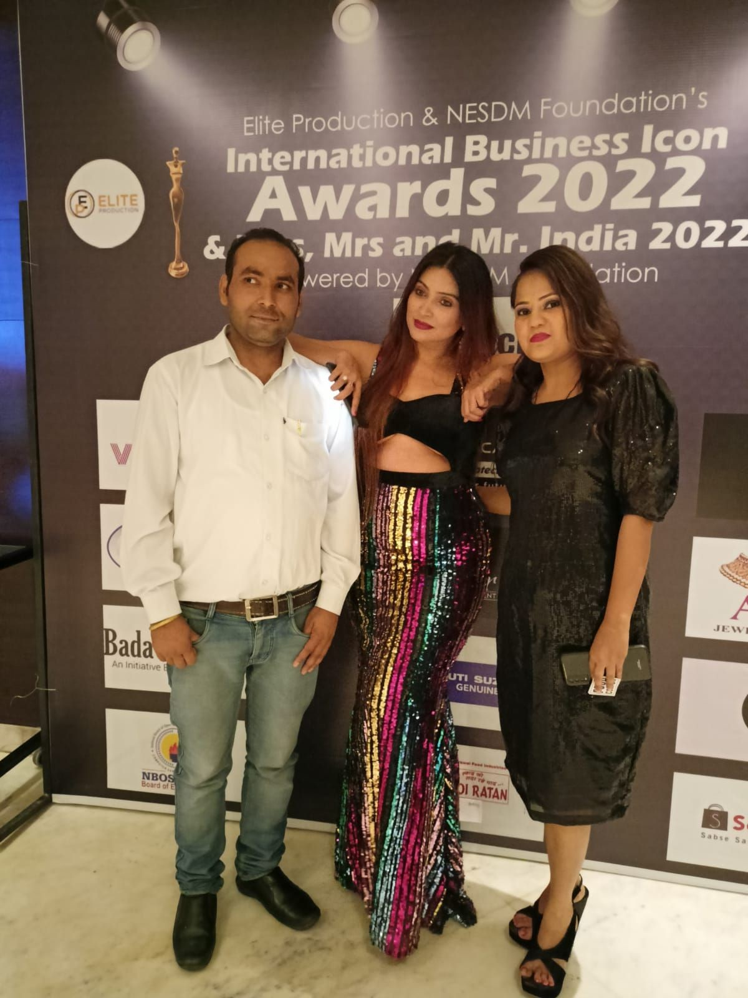
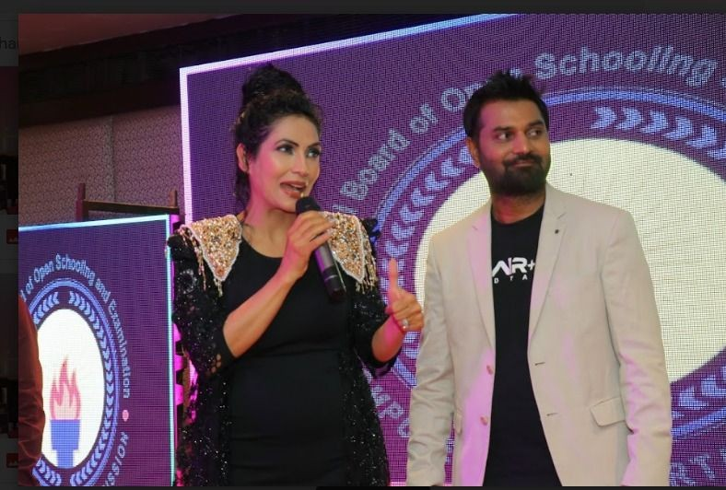
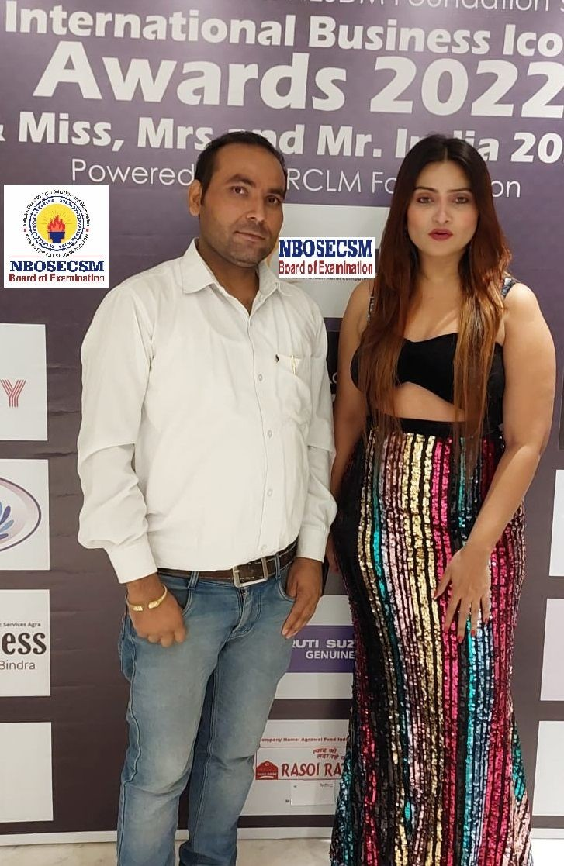
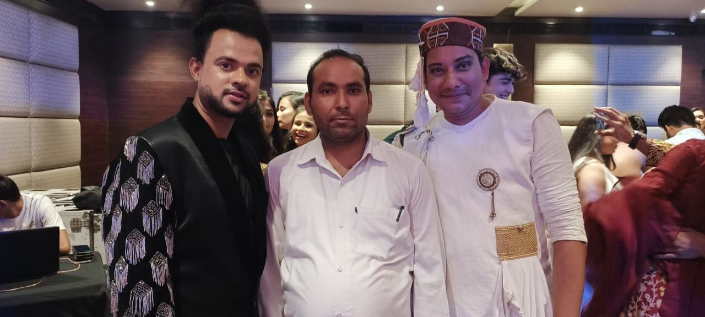

Slide 15

Award Nomination Categories

Slide 16
Nomination Categories
We want to cheer each and every segment of the business society; as we believe that the smallest contribution can bring an enormous amount of change.
Through these awards we are going to recognise the various companies, entrepreneurs, service providers for their achievements in their respective ﬁelds and their outstanding performance.

Slide 17
Nomination Categories
Nominations are open for all the below listed categories:
CATEGORIES | SUB-CATEGORIES
HOSPITALITY, LEISURE AND TOURISM | Restaurants Lounge Bar Coffee House Tour Operators Hotel Serviced Apartments
HEALTHCARE & WELLNESS | Dentistry / Dentist Cosmetic Surgeons Dermatologist Nutritionist Skin Clinic Dietician Gymnasium Spa, Sauna and Jacuzzi Beauty Salon Slimming centres

Slide 18
CATEGORIES
SUB-CATEGORIES
EDUCATION
Training and placement Institutes
Coaching centers
Private or public tuition centers
Graduation or post graduation degree Institutes
STORES & RETAIL
Shopping malls
Emporium malls
Clothing showrooms
Jewellery showrooms
Cars and bikes
OTHER CATEGORIES
** NOTE: In case your business do not fit in any of the categories mentioned here please get in touch with us,
we will help in filing your nomination for the Business Icon Awards
Wedding & Candid Photographers, Interior Designers, Architects
Makeup Artists
Event Planners, Wedding Planners, Fashion Designers, Tattoo Artists
Dance Studios, Fitness Centres, Caterers And many more…

Slide 19
Award Titles

Slide 20
Award Titles
Awards will be given in the form of trophies and monuments that suit the title that the winner holds.
Nbosecsm Education Foundation is honouring 2022 business achievers through this event; award titles are defined by looking at the characteristicsofthebusinessman, his/ herachievementsagainst the odds and what sets them different from thecrowd.
We have awards of various titles such as:
●
~Dynamic Entrepreneur of the Year(Business Transformation): This award will be given to the one who has achieved his goal and created a name for himself despite the tough market competition and numerous hurdles a businessman has to face.

Slide 21
Award Titles
~Professional Entrepreneur of the Year: This award will be given to the smart businessman who knows how to encash the market when situations are not favorable for his existing business and switches to other business temporarily by seeing market conditions.
~Social Entrepreneur of the Year: This award will be given to the businessmen with a kind heart who keeps donating part of his income for the welfare of the society, employees the needy ones and is well known among the businessgroups
~Brand of the Year

Slide 22
Award Titles
~International Business Woman of the Year
~ International Businessman of the Year
~ International Young Entrepreneur
~ International
~ International
Lifetime Achievement Award Education Excellence Award

Slide 23

INTERNATIONAL
Business Icon
Awards 2024
AGRA, UP.Date : COMMING SOON

Slide 24

We provide :
-Winner price
-1st Runner up
-2nd Runner up
31000\-
21000\-
11000\-
BRAND AMBASSADOR CONTRACT
HAIRSTYLIST GROOMING
ONE DESIGNER OUTFIT EVENING GOWN
CROWN , SASH
TROPHY & CERTIFICATE GIFT HAMPER
HOTAL STAY FREE VOCHER
JEWELLERY VOCHER
WEB SERIES
–Big Crown & Award
–lot of Gifts
–Music video Contract
–Brand Endorsement
–Webseries
–Photo Shoot

Slide 25
Event Attendees

Slide 26

Chief Guests
Actress / Modal

Slide 27

Sponsorship Packages

Slide 28
Sponsorship Packages
We have four different packages upon registering for any of them, you can be our sponsor or event partner. Each package offers different features and beneﬁts.
Standard 50,000 INR
Premium 1,00,000 INR
Super Premium 1,50,000 INR
Extra Super Premium 2,00,000 INR

Slide 29

Sponsorship Packages
Standard sponsorship package worth rs 50,000 _{is} a basic package and is meant for the sponsors who will get the
following beneﬁts from this business event:
Business endorsement and promotion online and offline; Social media presence, Onsite Advertising, Stage promotion
Branding ad at the venue and across AGRA
The event will be attended by all the top business people and VIPs all over UP state as well as across pan India. The bigshots from business,politics and social circles are part of the event, in the presence of 200 Key Entrepreneur's, Businessmen & women and Social activists, from different fields and CEOs & representatives of leading Organizations, you stand a chance to share your business ideas with them, mingle with them and make contacts
Chance to grab your future business investors or partners

Slide 30
Sponsorship Packages - 50,000 INR
Chance to convey your business details and make contacts with VIPs and key people from all over INDIA
Part of the inaugural ceremony that includes the lighting of the Inauguration Lamp along with the Chief Guest.
Part of welcome ceremony that include presentation of Welcome
Bouquet to the Chief Guest
Memento from event guests
Certificate from event guests.
All time presence in this entertainment and information filled event including food, snacks and drinks

Slide 31
Sponsorship Packages - 1,00,000 INR
Premium sponsorship package worth rs 1,00,000 is a customised package that will offer you many more beneﬁts from this business event. This package gives you Standard pack beneﬁts + the other added beneﬁts.

Slide 32
Sponsorship Packages - 1,00,000 INR
Business endorsement and promotion online and offline; Social media presence, Onsite Advertising, Stage promotion
Branding ad at the venue and across AGRA
The event will be attended by all the top business people and VIPs all over UP state as
well as across pan India. The bigshots from business,politics and social circles are part of the event, in the presence of 200 Key Entrepreneur's, Businessmen & women and Social activists, from different fields and CEOs & representatives of leading Organizations, you stand a chance to share your business ideas with them, mingle with them and make contacts
Chance to grab your future business investors or partners
Chance to convey your business details and make contacts with VIPs and key people from all over INDIA
Part of the inaugural ceremony that includes the lighting of the Inauguration Lamp along with the Chief Guest.

Slide 33
Sponsorship Packages - 1,00,000 INR
Part of welcome ceremony that include presentation of Welcome Bouquet to the Chief Guest
All time presence in this entertainment and information filled event including food, snacks and drinks
Unique platform that can be used to build new work partnerships and collaboration avenues and highlight social issues so that the much required change starts.
Sponsor's Name/Brand Logo will appear as sponsor in all Advertisements, Invitation Cards, Stage Backdrop, LED ads, Banners, Hoarding, Podium, etc.
The logo will form a part of the award title 'Business Icon Awards’ and will always be placed over and above the title.

Slide 34
Sponsorship Packages - 1,00,000 INR
Ramp Walk with models
Your story from being a normal working person to a businessman will be highlighted by the host
Display of your work and journey on LED backdrop display
Media coverage by News paper, News Channels, social media
Memento from the celebrity Guest
Certificate of achievement from the celebrity Guest

Slide 35


Sponsorship Packages - 1,50,000 INR
Super Premiumsponsorship package worth rs 1,50,000 is a package that will offer you beneﬁts of Standard pack + Premium pack + more value added beneﬁts.

Slide 36
Sponsorship Packages - 1,50,000 INR
The winners will be on a new high, a fast-track route to recognition of their unflinching commitment towards customer satisfaction through an extensive PR campaign in web, print and TV media.
They'll enjoy publicity that will establish their reputation as a proven provider of quality products and exemplary levels of services.
The award ceremony will be covered by leading newspapers and TV channels.
Business endorsement and promotion online and offline; Social media presence, Onsite Advertising, Stage promotion

Slide 37
Sponsorship Packages - 1,50,000 INR
The event will be attended by all the top business people and VIPs all over UP state as well as across pan India. The bigshots from business,politics and social circles are part of the event, in the presence of 200 Key Entrepreneur's, Businessmen & women and Social activists, from different fields and CEOs & representatives of leading Organizations, you stand a chance to share your business ideas with them, mingle with them and make contacts
Be there in the front row near celebrities during the inaugural ceremony that includes the lighting of the Inauguration Lamp along with the Chief Guest.

Slide 38
Sponsorship Packages - 1,50,000 INR
Chance to present welcome Welcome Bouquet to the Chief celebrity Guests
Sponsor's Name/Brand Logo will appear as sponsor in all Advertisements, Invitation Cards, Stage Backdrop, LED ads, Banners, Hoarding, Podium, etc.
The logo will form a part of the award title 'Business Icon Awards’ and will always be placed over and above the title.
Memento from the celebrity Chief Guest
Certificate of achievement from the celebrity Chief Guest
Appreciations speech from celebrity Guest

Slide 39
Sponsorship Packages - 1,50,000 INR
Memento from the celebrity Chief Guest
Sharing dais with the celebrity Chief Guest
Get photographed with the celebrity Chief guests
A video clip of your success story on LED screen
Your story from being a normal working person to a businessman will be told by host
Media coverage by News paper, News Channels, social media
Your business marketing and ad through main backdrop, visual projection, outdoor media, product display, social media, print media, entrance arch, etc.
Interaction with celebrity Chief Guest

Slide 40
Sponsorship Packages - 1,50,000 INR
Chance to present welcome Welcome Bouquet to the Chief celebrity Guests
Sponsor's Name/Brand Logo will appear as sponsor in all Advertisements, Invitation Cards, Stage Backdrop, LED ads, Banners, Hoarding, Podium, etc.
The logo will form a part of the award title 'Business Icon Awards’ and will always be placed over and above the title.
Memento from the celebrity Chief Guest
Certificate of achievement from the celebrity Chief Guest
Appreciations speech from celebrity Guest

Slide 41



Contact Us

Slide 42

To register with us as sponsor or event partner, or if you have any queries or doubts you can reach to us at the following numbers and email
Email: nboseindian@gmail.com
Website – www.nbosecsm.com
Call:
+91 7017410243, / 9675026934
+91 789564125, / 8126336547
+91 7668304952

Slide 43
Thank you!

